Slide 1
WTWY Annual Gala: Community Outreach Plan
By Lucas Schwartz, Lucy Hu, and Nick Lund

Slide 2
Project Goals:
Acquire as many sign-ups as possible from Women in tech
Use volunteers as efficiently as possible
Gather signatures on weekends even though people won’t be at work

Slide 3
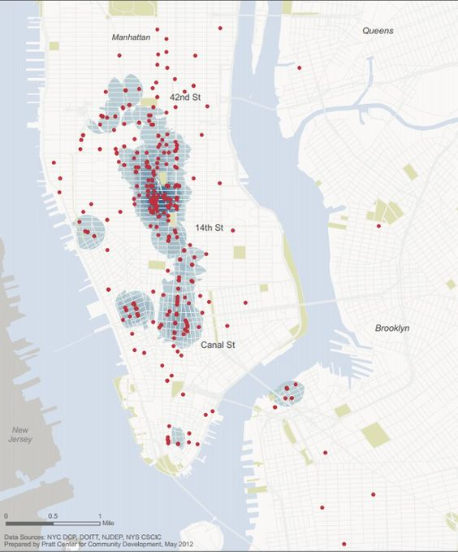
Considerations
For weekday locations:
Ridership
Exit theory
Major tech companies
Non-touristy places
A Map of New York Tech Companies Since 2006.

Slide 4
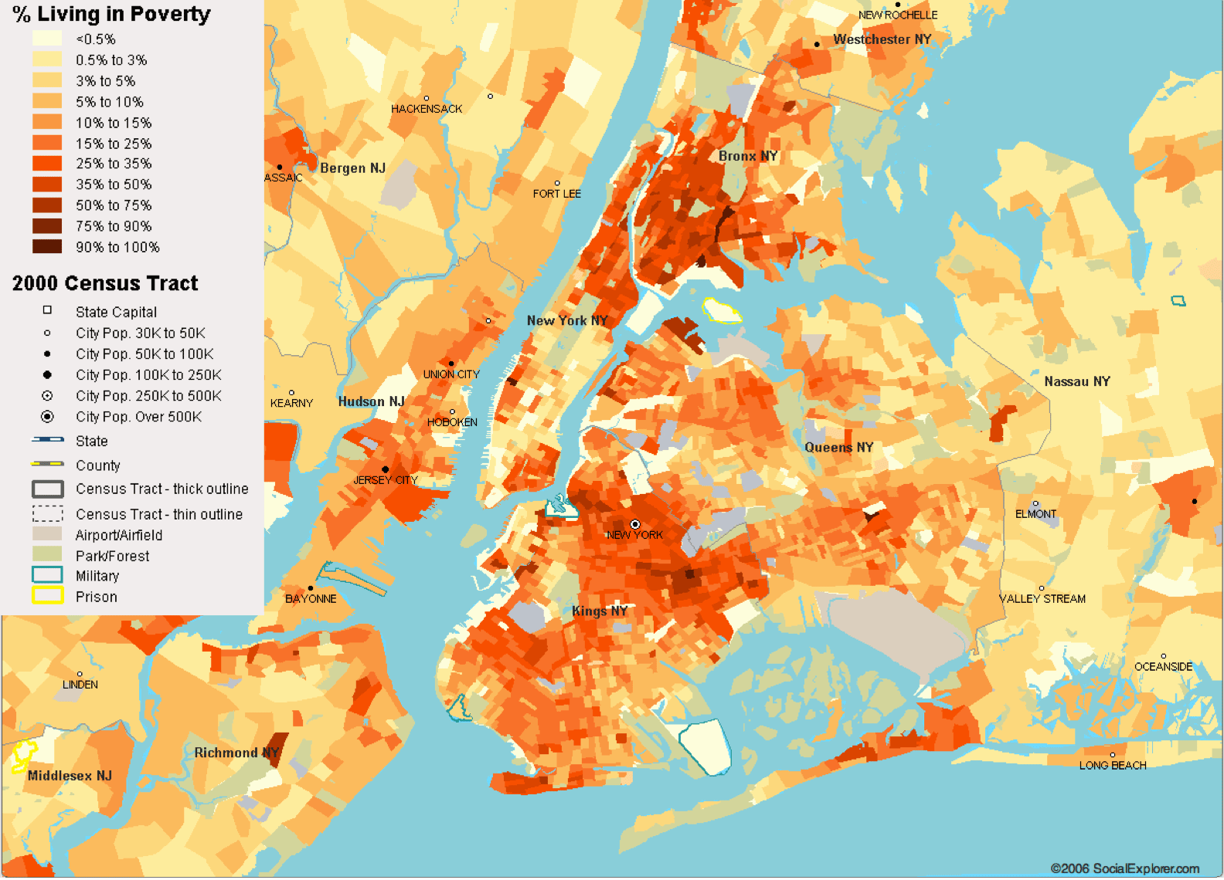
Considerations
For weekend locations:
Ridership
Exit theory
Wealthy neighborhoods
Non-touristy places
New York City Poverty Map

Slide 5
Thinking Process
• We started by searching for the top 10 biggest tech companies in NYC before looking at the data.
• We wrote code to rank stations by highest to lowership ridership on Saturday and Monday (to represent weekends and weekdays respectively).
• For the weekdays, we selected the top three most popular stops that correlated with the tech companies we researched.
• For weekends, we selected the most popular stops in areas where people working in tech would be (wealthy neighborhoods or by universities)
Notes:
• For the weekdays, we selected the top three most popular stops that correlated with the tech companies we researched. We also—>top 2 most popular stops
• For weekends, we selected the most popular stops in areas where people working in tech would be (wealthy neighborhoods or by universities)

Slide 6
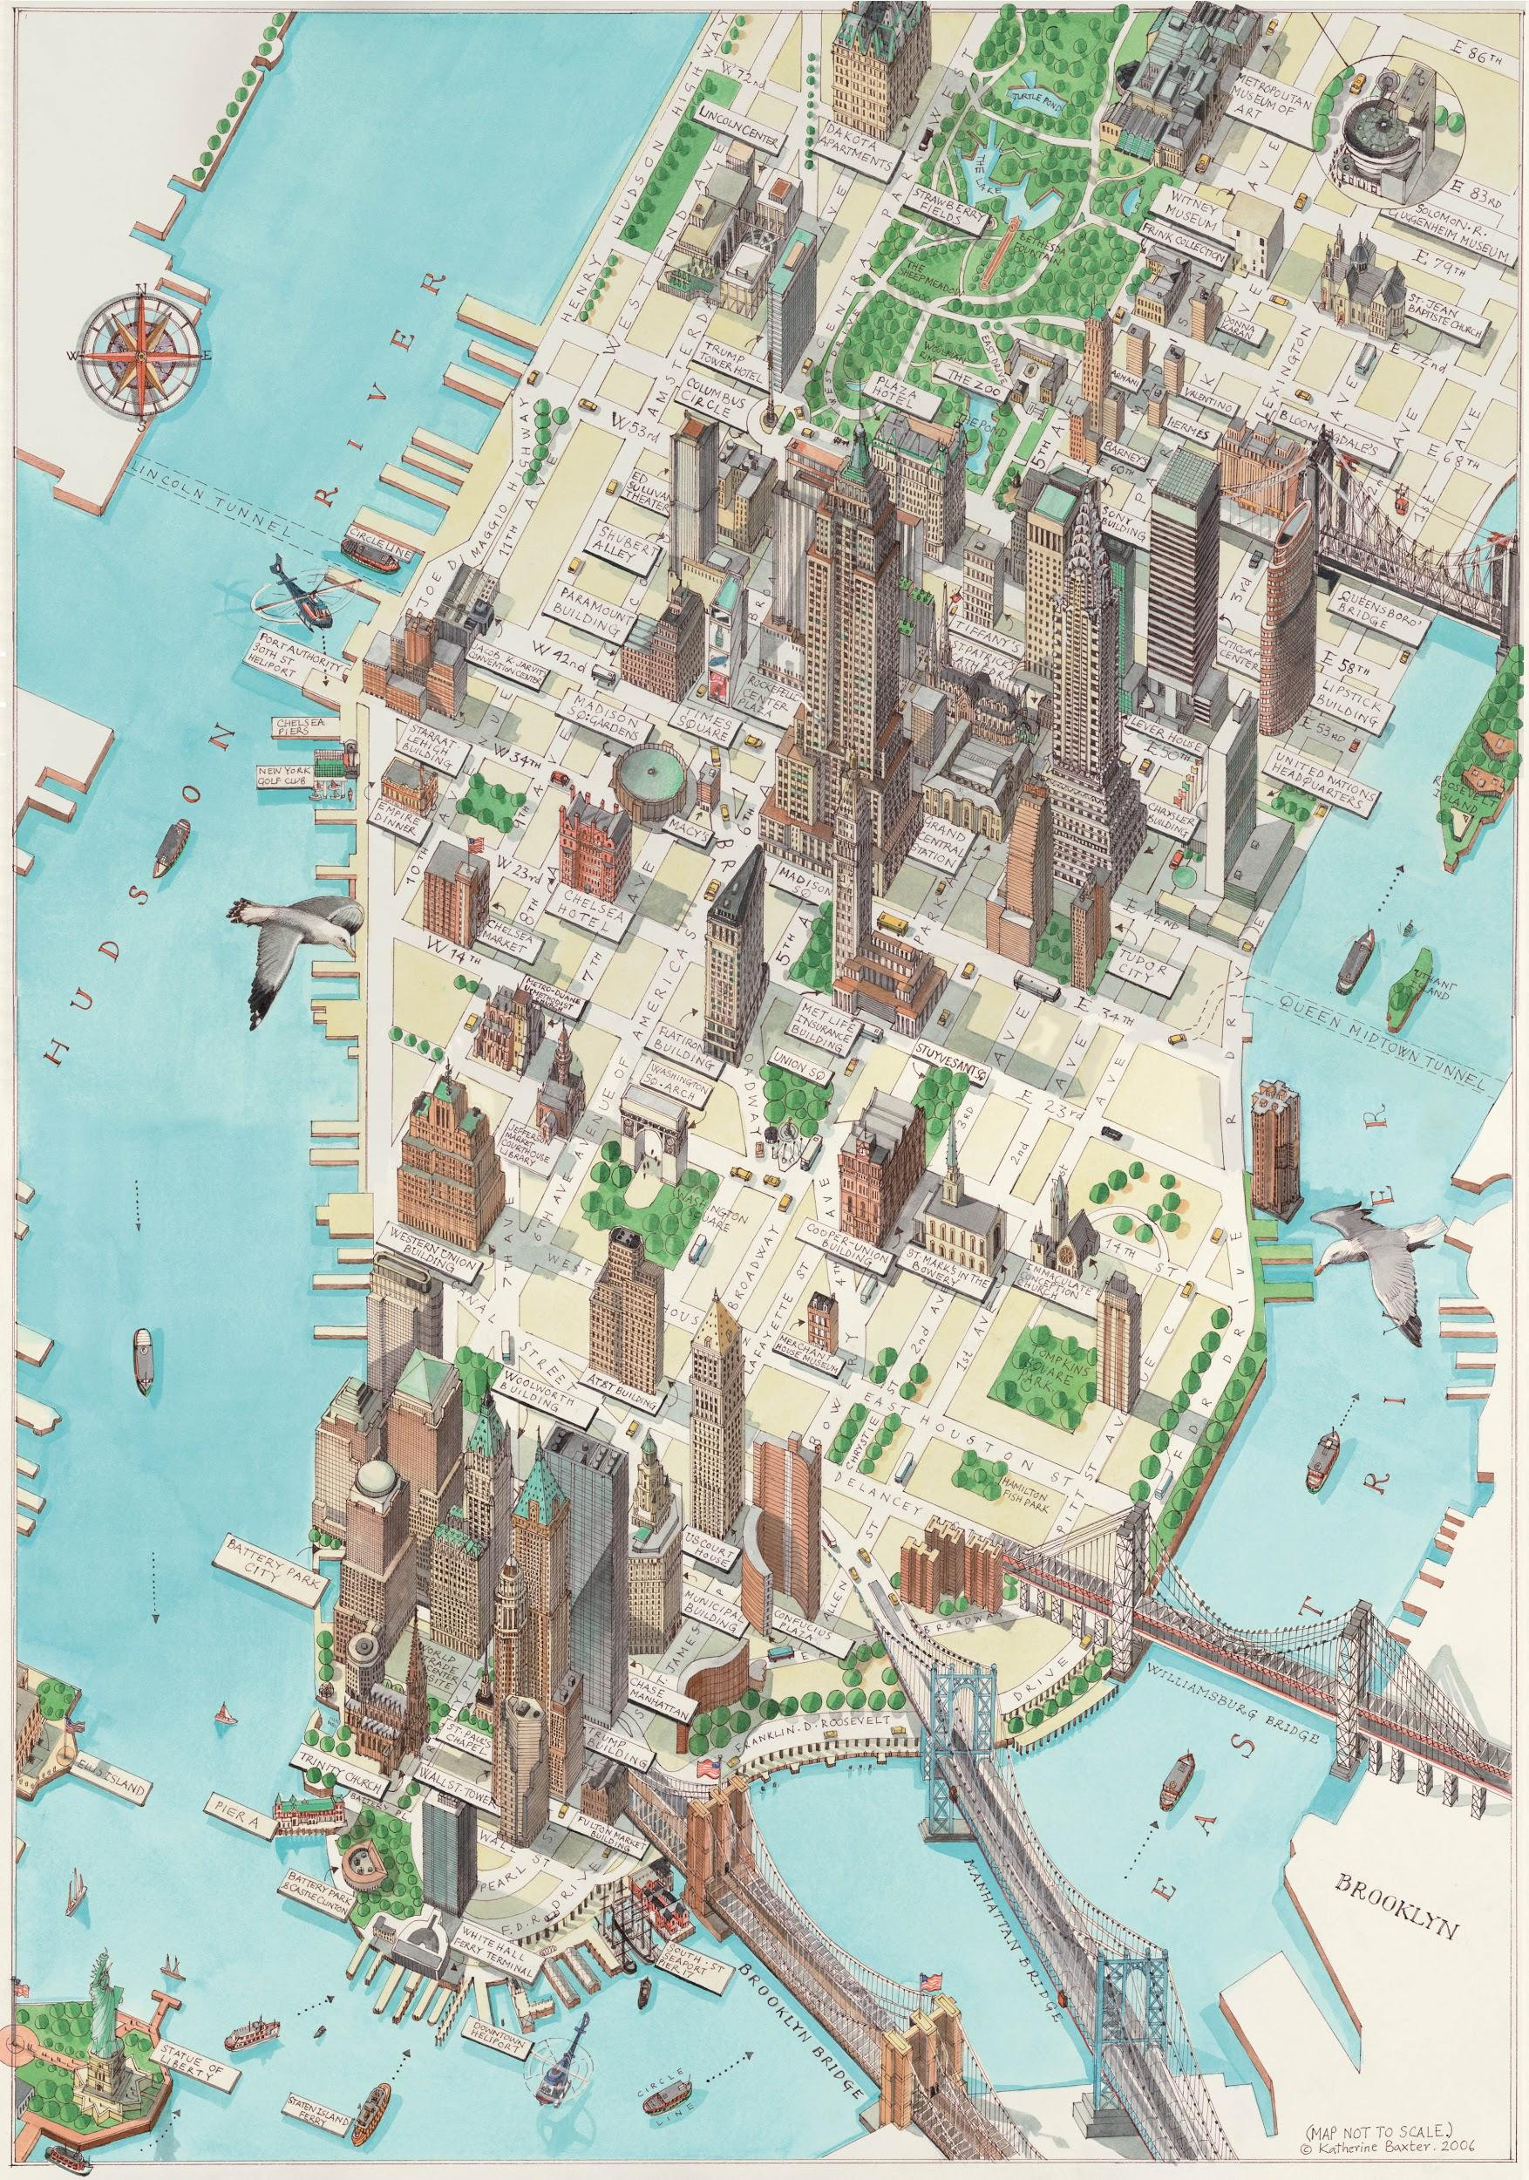
Weekday Stops
66 St Lincoln Station
ABC
CNN
CBS
NY IT
Fordham University
Rockefeller Center Station
Comcast
NBC
Grand Central Station
8th Ave Station
Google
Penn Station
Notes:
Entertainment companies
Popular station:

Slide 7
Weekend Stops
125 St Station
Columbia University
Canal St Station
86 St Station
23 St Station
34 Street-Herald Square Station
Notes:
Canal St Station - SoHo District
23rd Street Station - Flatiron
125th St Station - Harlem not wealthy but columbia University
86th Street Station - Upper east side
34th Street-Herald Square Station - Midtown

Slide 8
Takeaways
We recommend putting 2 people at each station working shifts of:
  7am-9am, 4pm-6pm on weekdays
  10am-2pm on weekends
What sets us apart:
  Exit theory
  Weekend stops target residences
  Weekday stops target both major tech companies AND large commuter stops

